Slide 1
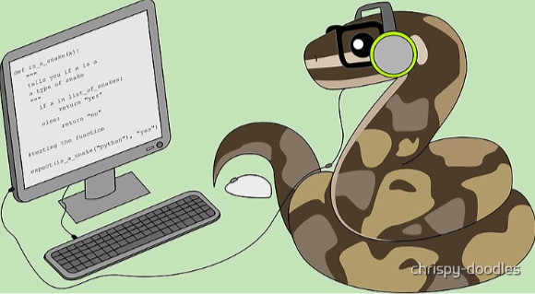
Introduction to Python and AI Assisted Coding

Slide 2
Goals for this Week
Monday February 9th
Introduction to Using Python
•Good Habits/Grammar
•Basics
•Object Types
•Comments
•Simple Functions
•Variables and Naming Conventions
•Formats for Python
Wednesday February 11th
Foundational Tools
•Lists
•Dictionaries
•File Handling
•Indexing
•Loops and Conditions

Slide 3
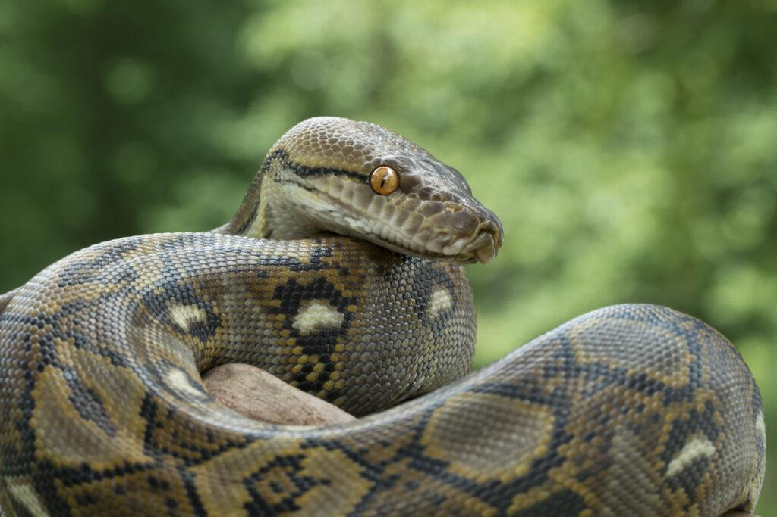
What is Python?
Pythonidae family
~10 species
Native to tropics of Eastern Hemisphere (Africa and Asia)
Constricting snake

Slide 4
What is Python - How it Works
For every person in the room
zig-zagging starting from the person in the left corner closest to me
Say Your Name and your department
If your name starts with a vowel - clap your hands
If your name starts with a consonant - snap your fingers
If you are not in the wrong class, please let me know

Slide 5
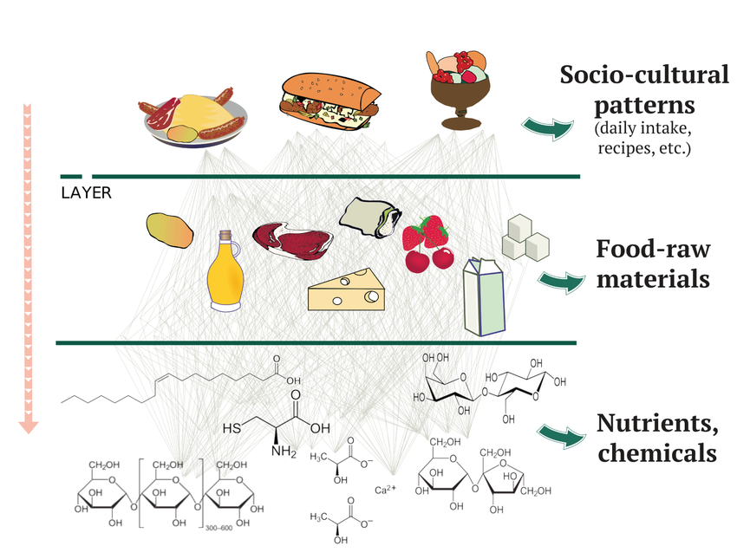
What is Python-Layers of Abstraction

Slide 6

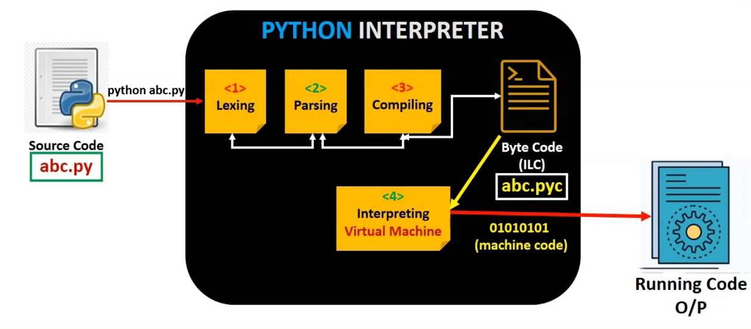
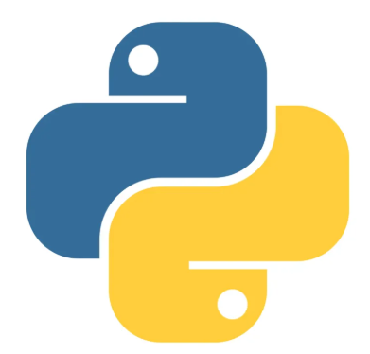


What is Python – Interpreted Languages
Abstraction
User Friendliness
Visual
Drag-and-Drop Programming
Interpreted Language
Compiled Language (C, C++)
t2 = t6 + t2
Assembly Code (Intel X86)
add $t2 $t6 $t2
Machine Code (Hexadecimal)
0x014E5156
Complexity
Speed
Binary Code
00000001010011100101000101010110

Slide 7
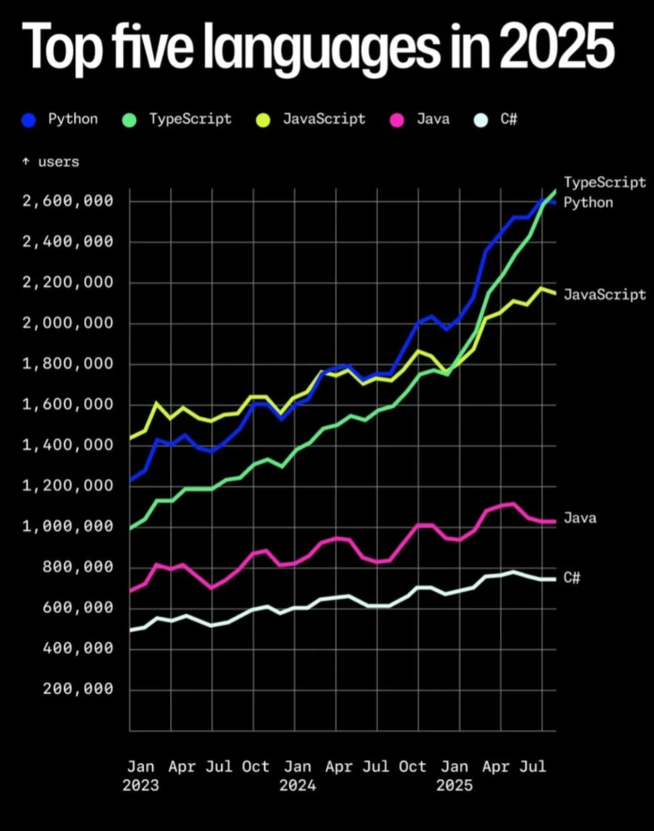
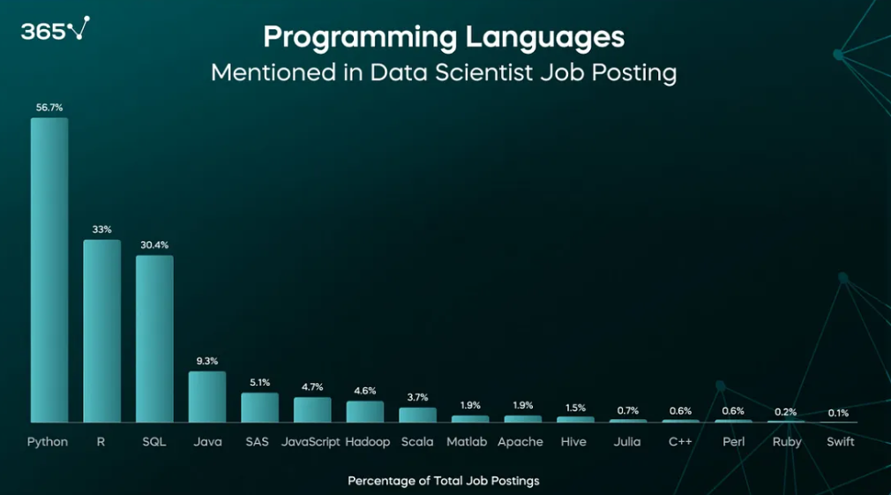
Python continues to be the most widely used general interpreted language

Slide 8
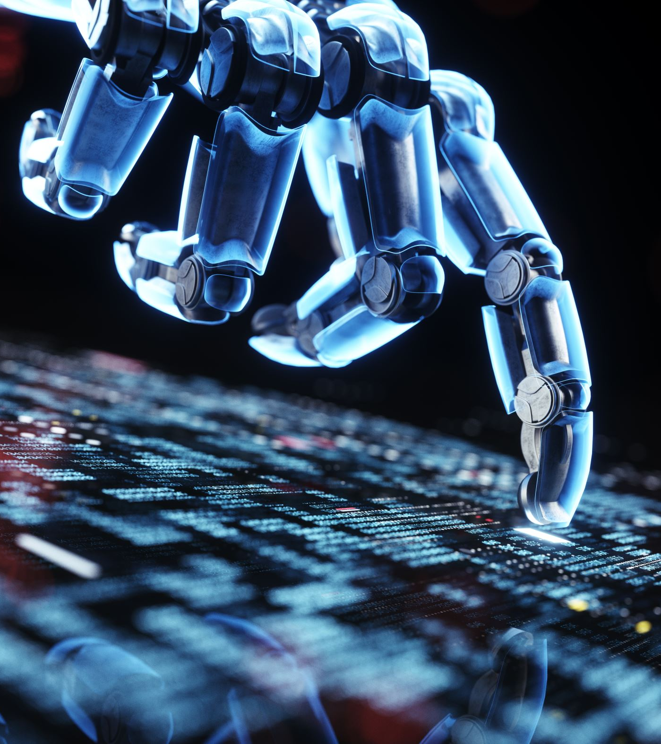
What can you use it for?
Data Analysis and Visualization
Backend web development
Apps / Games
Productivity / Automation / Pipelines
Web Scraping
Machine Learning

Slide 9
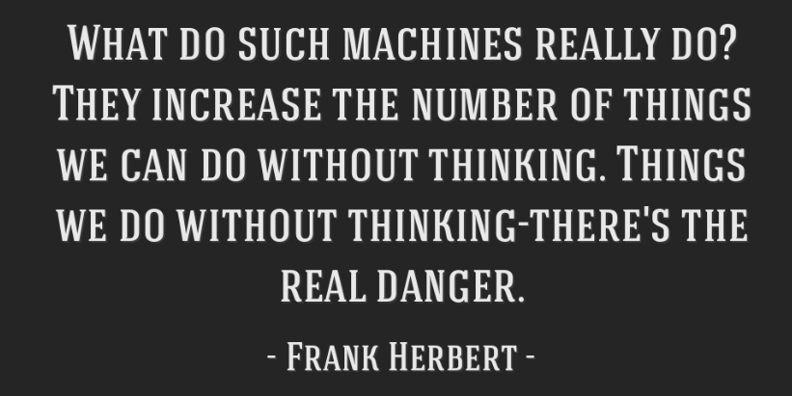
Rules for Chat GPT / Claude/ AI Tools
USE IT FOR:
Finding functions you need
Double checking your work, improving it
Dealing with errors you cannot solve on your despite trying
*Remember the Butlerian Jihad*
DO NOT USE IT FOR:
Errors you have not tried to solve
Having it write the code for you

